Slide 1
Management of toxicities from immunotherapy
ESMO Clinical Practice Guidelines for diagnosis, treatment and follow-up
J. Haanen, F. Carbonnel, C. Robert, K. Kerr, S. Peters, J. Larkin and K. Jordan,
on behalf of the ESMO Guidelines Committee
*For details of author affiliations, correspondence and versions, please see the full version at esmo.org/Guidelines/Supportive-and-Palliative-Care

Slide 2
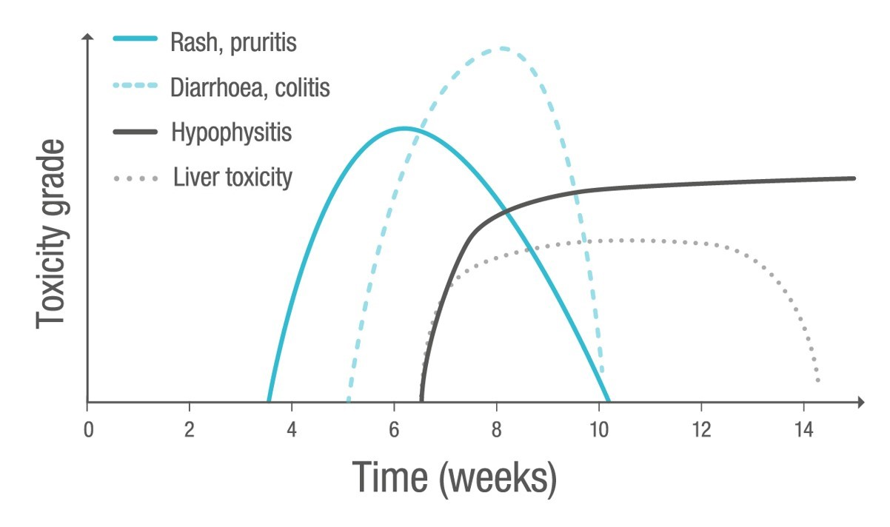
Incidence and epidemiology
Time to onset and resolution of occurrence of immuno-related adverse events following Ipilimumab treatment
Weber JS et al. J Clin Oncol 2012;30:2691–2697. Reprinted with permission. ©2012 American Society of Clinical Oncology. All rights reserved.
© 2018 ESMO. All rights reserved. esmo.org/Guidelines/Supportive-and-Palliative-Care/Management-of-Toxicities-from-Immunotherapy

Slide 3
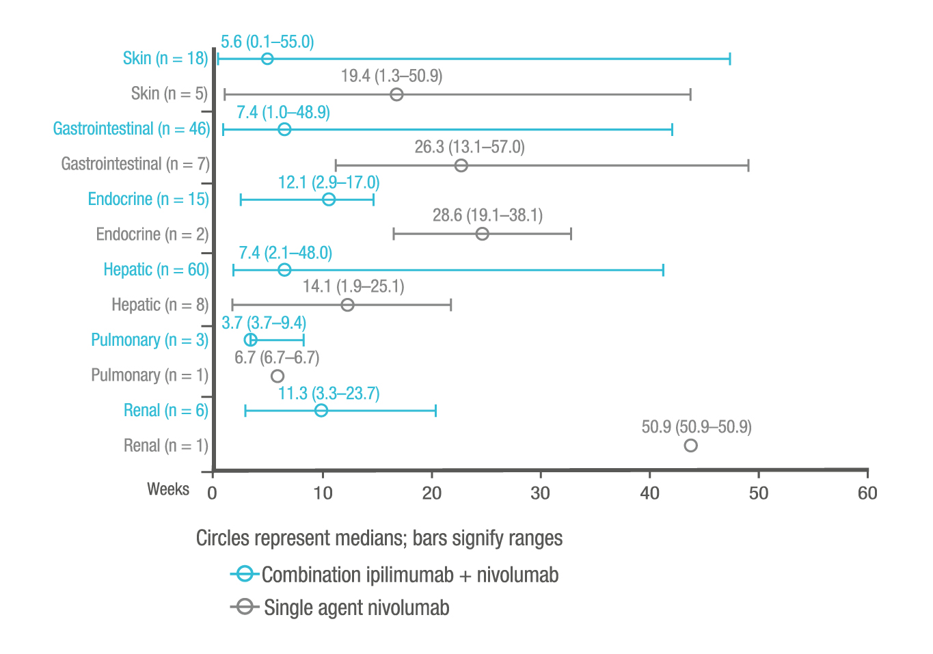
Incidence and epidemiology
Time to onset of grade 3-4 treatment-related select adverse events
Larkin J et al. Presented at ECC 2015;Abs330. Reprinted with permission.
© 2018 ESMO. All rights reserved. esmo.org/Guidelines/Supportive-and-Palliative-Care/Management-of-Toxicities-from-Immunotherapy

Slide 4
Summary of recommendations
General aspects of immune-related adverse events (irAEs) | Generally occur within 3 months after initiation of ICPi treatment
 | Tissue biopsy may be useful for higher grade (3-4) toxicities, when there is diagnostic doubt and management would be altered by the outcome
Patient selection and baseline assessments | Before starting treatment: patients’ susceptibility to irAEs should be assessed and patients informed of the potential AEs, reporting directly to the treating physician or team
 | Work-up should include: history, general physical condition, autoimmune diseases, baseline laboratory tests and radiological scans If current or previous autoimmune disease: risk of worsening of their autoimmune disease while on ICPi treatment If previous ipilimumab-related irAEs: risk of developing irAEs following anti-PD-1 treatment, and vice versa
 | Once irAEs have developed, prompt work-up and action are required
 | Pneumocystis prophylaxis should be considered for patients receiving long-term (> 6 weeks) treatment with immunosuppressive drugs
 | The clinical outcome of patients on ICPi treatment is not affected by the use of immunosuppressive agents for the management of immune-related toxicities
Incidence and epidemiology
© 2018 ESMO. All rights reserved. esmo.org/Guidelines/Supportive-and-Palliative-Care/Management-of-Toxicities-from-Immunotherapy

Slide 5
Summary of recommendations
Any other aetiology of skin problem, such as infection, an effect of another drug or a skin condition linked to another systemic disease, should be ruled out
The severity of the reaction should be evaluated by a careful and thorough physical examination of the skin, including the mucosal areas, and patient’s general health status
A biological assessment, including blood cell count and liver and kidney tests, may be required to rule out dermatological emergencies In severe cases, ICPi treatment should be permanently discontinued, the patient hospitalised and symptomatic treatment initiated immediately
Severity of maculopapular rash should be classified according to the CTCAE version 4.0
Immune-related skin toxicity
Diagnosis and pathology/molecular biology
© 2018 ESMO. All rights reserved. esmo.org/Guidelines/Supportive-and-Palliative-Care/Management-of-Toxicities-from-Immunotherapy

Slide 6
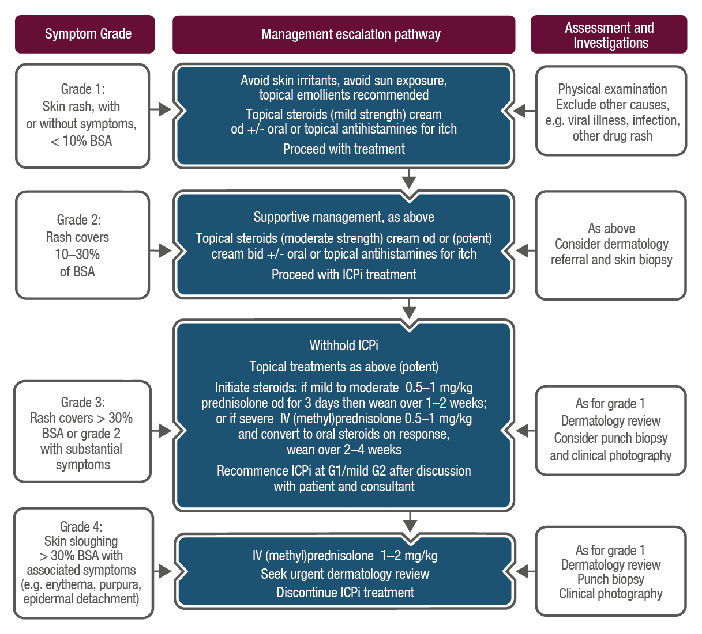
Immune-related skin toxicity
ICPi-related toxicity: Management of skin rash/toxicity
Recognised skin AEs include:
Most common: Erythema, maculopapular and pustulopapular rash
Rare: TEN, Steven-Johnson syndrome and DRESS
Vasculitis may also be present with purpuric rash
© 2018 ESMO. All rights reserved. esmo.org/Guidelines/Supportive-and-Palliative-Care/Management-of-Toxicities-from-Immunotherapy

Slide 7
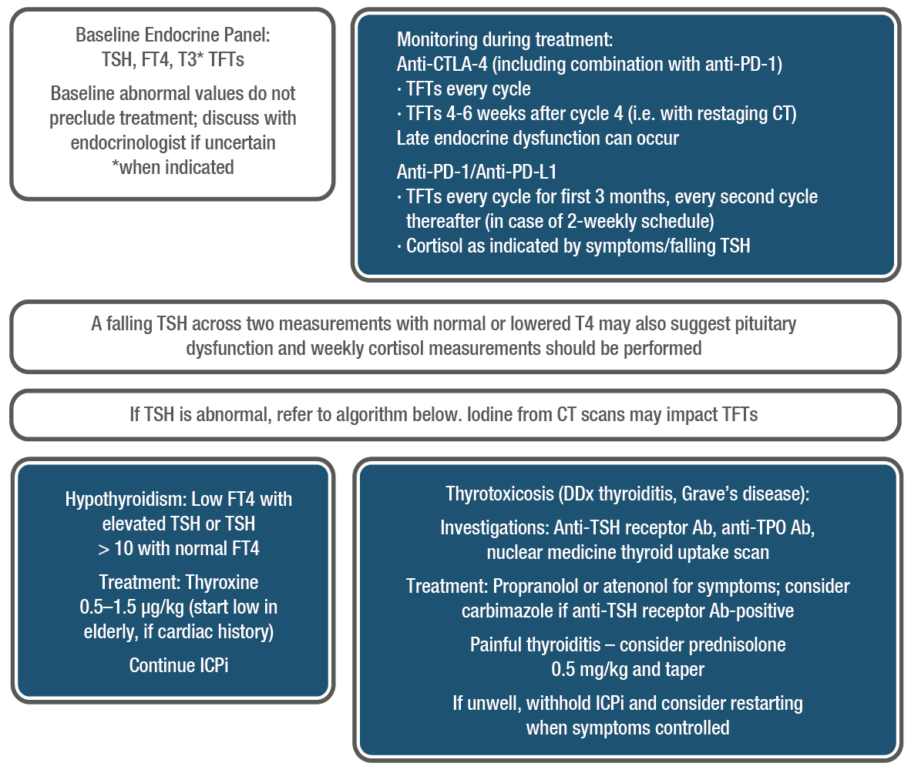
Immune related toxicities - endocrinopathies
ICPi monitoring and management: Thyroid function
© 2018 ESMO. All rights reserved. esmo.org/Guidelines/Supportive-and-Palliative-Care/Management-of-Toxicities-from-Immunotherapy

Slide 8
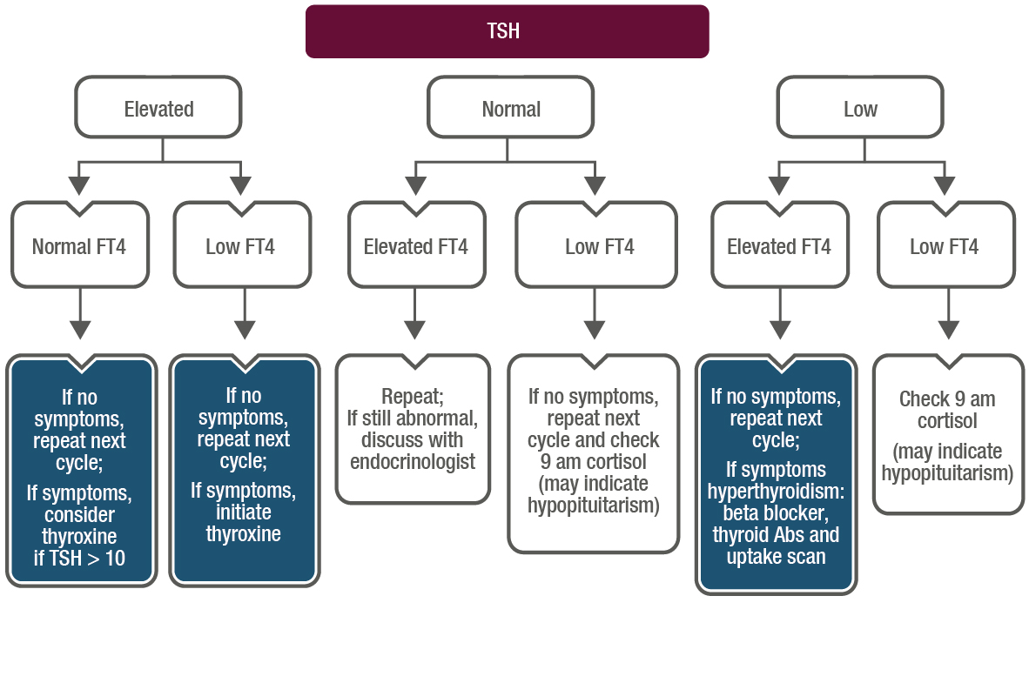
Immune related toxicities - endocrinopathies
ICPi monitoring and management: Thyroid function (cont’d)
Withhold ICPi if patient is unwell with symptomatic hyperthyroidism
Subclinical hyperthyroidism (low TSH, normal FT4) often precedes overt hypothyroidism
© 2018 ESMO. All rights reserved. esmo.org/Guidelines/Supportive-and-Palliative-Care/Management-of-Toxicities-from-Immunotherapy

Slide 9
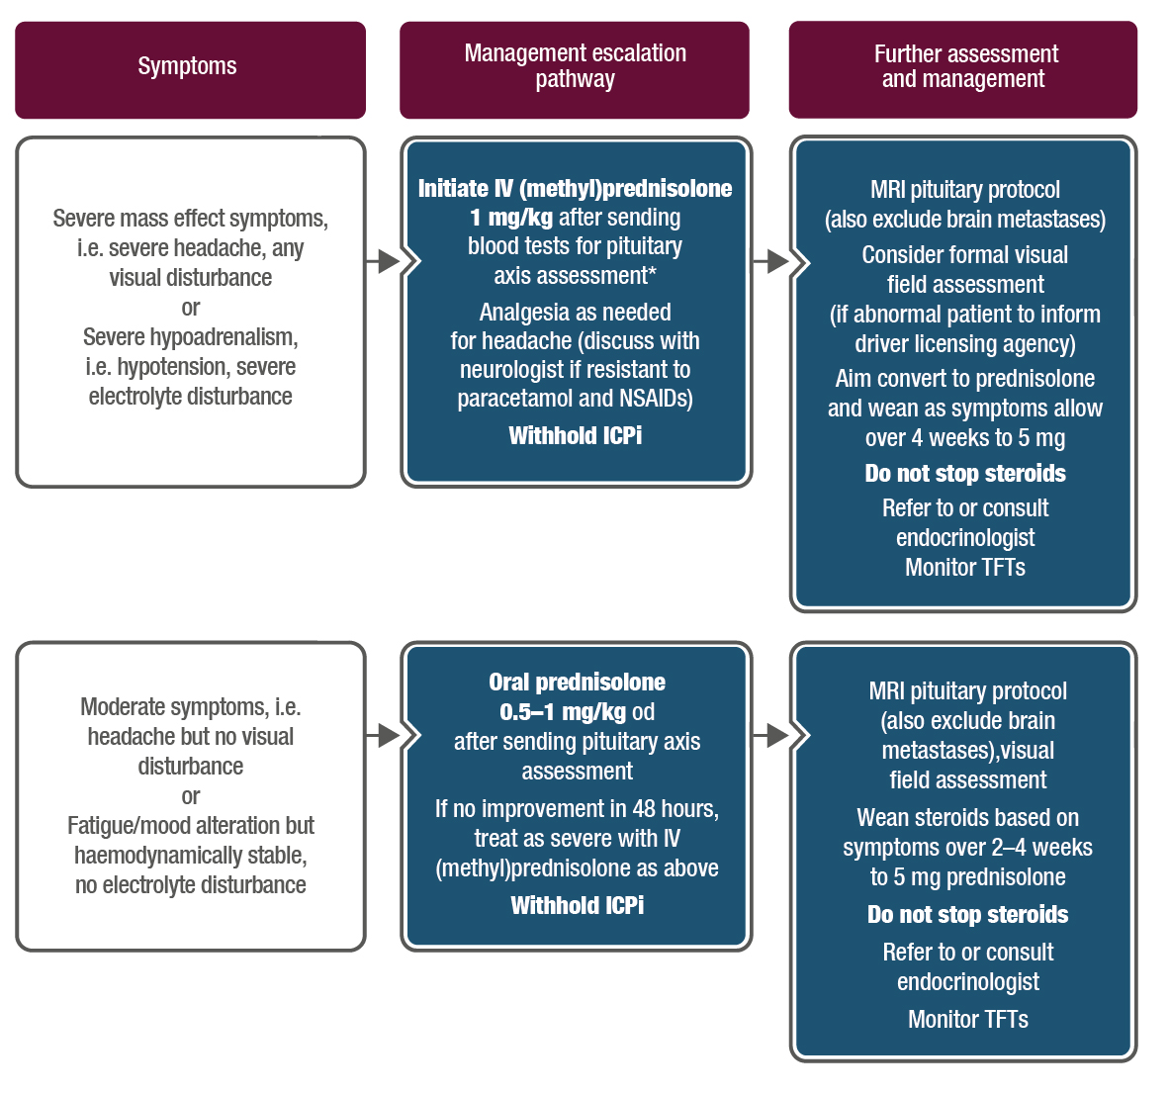
Immune related toxicities - endocrinopathies
ICPi related toxicity: Management of hypophysitis
*Pituitary axis bloods: 9 am cortisol (or random if unwell and treatment cannot be delayed), ACTH, TSH/FT4, LH, FSH, oestradiol if premenopausal, testosterone in men, IGF1, prolactin. Mineralocorticoid replacement is rarely necessary in hypopituitarism
© 2018 ESMO. All rights reserved. esmo.org/Guidelines/Supportive-and-Palliative-Care/Management-of-Toxicities-from-Immunotherapy

Slide 10
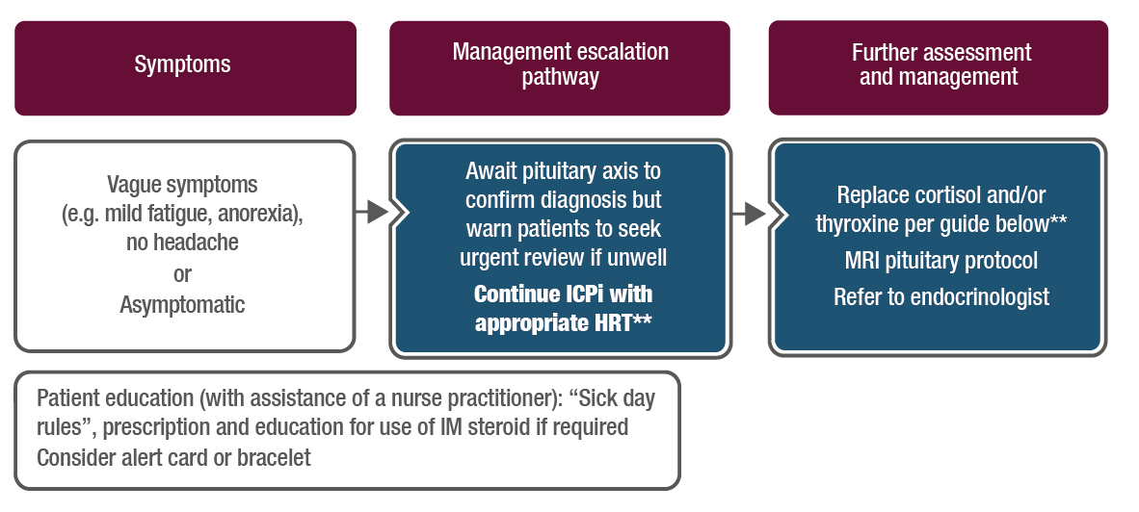
Immune related toxicities - endocrinopathies
ICPi-related toxicity: Management of hypophysitis (cont’d)
**Initial replacement advice for cortisol and thyroid hormones:
If 9 am cortisol < 250 nmol/L or random cortisol < 150 nmol/L and vague symptoms:
Replace with hydrocortisone 20/10/10 mg
If TFTs normal, 1–2 weekly monitoring initially (always replace cortisol for 1 week prior to thyroxine initiation)
If falling TSH +/- low FT4:
Consider need for thyroxine replacement (guide is 0.5–1.5 mg/kg) based on symptoms and/or check 9 am weekly cortisol
See thyroid section for further information regarding interpretation of an abnormal TSH/T4
© 2018 ESMO. All rights reserved. esmo.org/Guidelines/Supportive-and-Palliative-Care/Management-of-Toxicities-from-Immunotherapy

Slide 11
Summary of recommendations
Blood glucose levels should be regularly monitored in patients treated with ICPi in order to detect the emergence of de novo DM
Patients with Type 2 DM may develop ketoacidosis, which should be treated according to standard local guidelines
The role of high-dose steroids in preventing total loss of pancreatic beta cells is unclear and is not recommended
C-peptide and antibodies against GAD and islet cells can distinguish between Type 1 and Type 2 DM
Restarting ICPi treatment can be considered once the patient has been regulated with insulin substitution
Immune related toxicities - endocrinopathies
Type 1 diabetes mellitus
© 2018 ESMO. All rights reserved. esmo.org/Guidelines/Supportive-and-Palliative-Care/Management-of-Toxicities-from-Immunotherapy

Slide 12
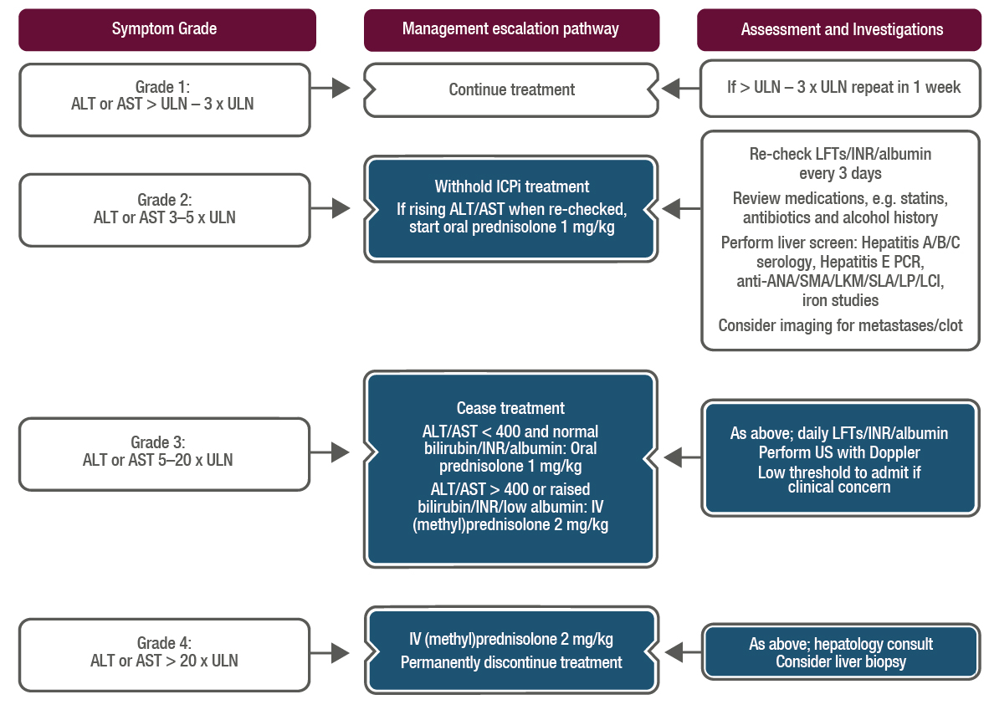
Immune related hepatotoxicity
ICPi-related toxicity: Management of hepatitis
Steroid wean:
Grade 2: Once grade 1, wean over 2 weeks; re-escalate if worsening; treatment may be resumed once prednisolone ≤ 10 mg
Grade 3/4: Once improved to grade 2, can change to oral prednisolone and wean over 4 weeks; for grade 3, re-challenge only at consultant discretion
Worsening despite steroids:
If on oral change to IV (methyl)prednisolone
If on IV add MMF 500–1000 mg bid
If worse on MMF, consider addition of tacrolimus
A case report has described the use of anti-thymocyte globulin in steroid + MMF-refractory fulminant hepatitis
© 2018 ESMO. All rights reserved. esmo.org/Guidelines/Supportive-and-Palliative-Care/Management-of-Toxicities-from-Immunotherapy

Slide 13
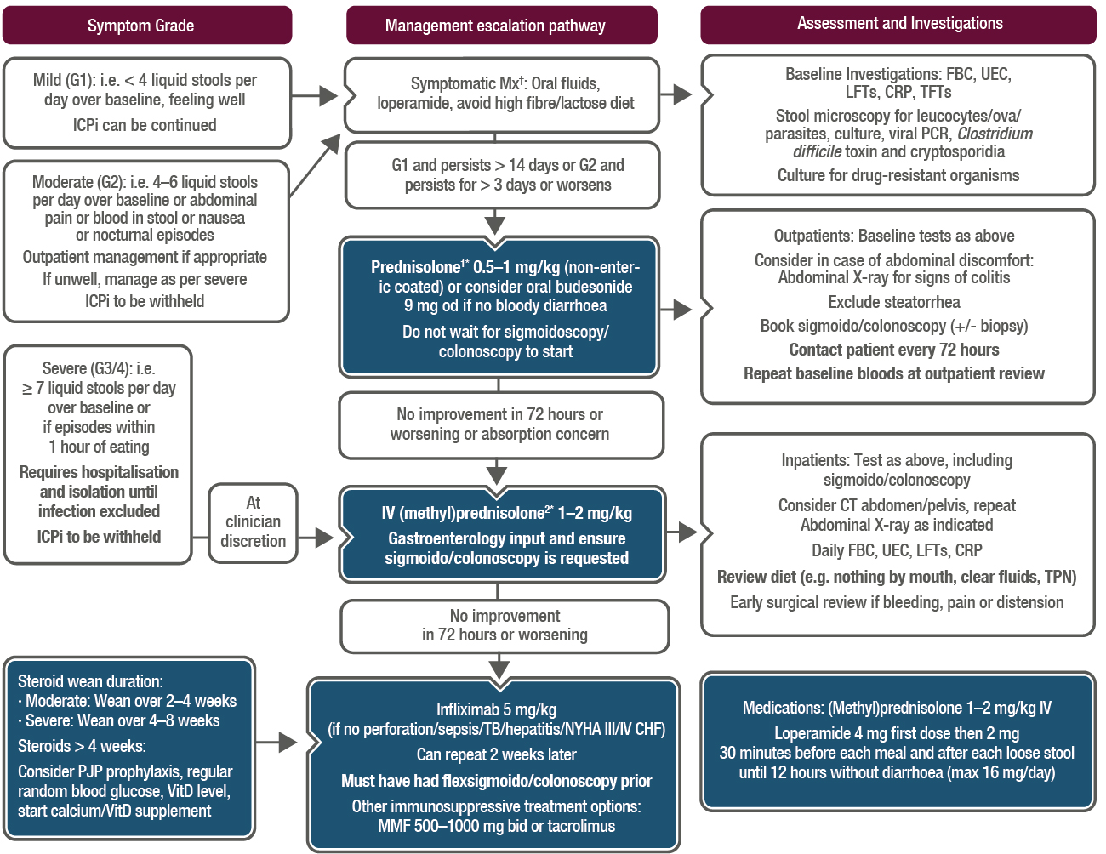
Immune related gastrointestinal toxicities
ICPi-related toxicity: Management of diarrhoea and colitis
†Loperamide 4 mg first dose then 2 mg 30 minutes before each meal and after each loose stool until 12 hours without diarrhoea (max 16 mg/day)
Steroid wean duration:
¹Moderate: wean over 2–4 weeks
²Severe: wean over 4–8 weeks
*Steroids > 4 weeks: Consider PJP prophylaxis, regular random blood glucose, VitD level, start calcium/VitD supplement
© 2018 ESMO. All rights reserved. esmo.org/Guidelines/Supportive-and-Palliative-Care/Management-of-Toxicities-from-Immunotherapy

Slide 14
Summary of recommendations
Most common symptoms | Diarrhoea, abdominal pain, hematochezia, weight loss, fever and vomiting, mouth ulcers, anal lesions and extra-intestinal manifestations (Upper GI symptoms and endoscopic lesions have been reported)
Main biological abnormalities | Anaemia, increased serum CRP and low serum albumin levels
Ruling out infection and cancer as causes | Bacterial enteropathogens and Clostridium difficile toxin content of stools and investigation of GI metastases
Further investigations | Flexible endoscopy can confirm the diagnosis of enterocolitis
Immune related gastrointestinal toxicities
GI toxicity of ICPIs (most commonly observed with anti-CTLA-4 alone or anti-CTLA-4 + anti-PD-1/PD-L1)
© 2018 ESMO. All rights reserved. esmo.org/Guidelines/Supportive-and-Palliative-Care/Management-of-Toxicities-from-Immunotherapy

Slide 15
Summary of recommendations
Management
Non-severe diarrhoea | Treatment with antidiarrhoeals, fluid and electrolyte supplementation, if required, and ICPis can be continued
Persistent grade 2 / severe grade 3–4 / grade 1-2 with alarm symptoms | ICPi discontinuation and initiation of systemic corticosteroids (1 to 2 mg/kg IV daily)
Response to IV corticosteroids | Responding (within 3–5 days): switch to the oral form, treatment tapered over 8–12 weeks Not responding: switch to infliximab 5 mg/kg (unless contraindicated)
Colonic perforation (with or without intra-abdominal abscess) | Emergency subtotal colectomy with ileostomy and endoscopy
Follow-up and long-term implications
Corticosteroids or infliximab treatment does not affect response and OS of patients treated with ipilimumab
Reintroduction of ICPi in patients previously experiencing enterocolitis is associated with a high risk of relapse - discuss on an individual basis
Immune related gastrointestinal toxicities
GI toxicity of ICPis – management, follow-up and long-term implications
© 2018 ESMO. All rights reserved. esmo.org/Guidelines/Supportive-and-Palliative-Care/Management-of-Toxicities-from-Immunotherapy

Slide 16
Summary of recommendations
Anti-PD-1
Common symptoms | Diarrhoea, nausea/vomiting and abdominal pain, with a median time to symptom onset of 3 months
Endoscopic findings | Normal mucosa through mild erythema to severe inflammation and histological findings include lamina propria expansion, villus blunting, intra-epithelial neutrophils and increased crypt/gland apoptosis
Different patterns of GI irAEs | Acute colitis Microscopic colitis Upper GI involvement Pseudo-obstruction
Combined anti-CTLA-4 and anti-PD-1 antibodies
With this combined treatment, pancreatitis and small bowel enteritis, which may be visible on CT scan, require ICPi treatment discontinuation and initiation of immunosuppression
Immune related gastrointestinal toxicities
GI toxicity of ICPIs (most commonly observed with anti-CTLA-4 alone or anti-CTLA-4 + anti-PD-1/PD-L1)
© 2018 ESMO. All rights reserved. esmo.org/Guidelines/Supportive-and-Palliative-Care/Management-of-Toxicities-from-Immunotherapy

Slide 17
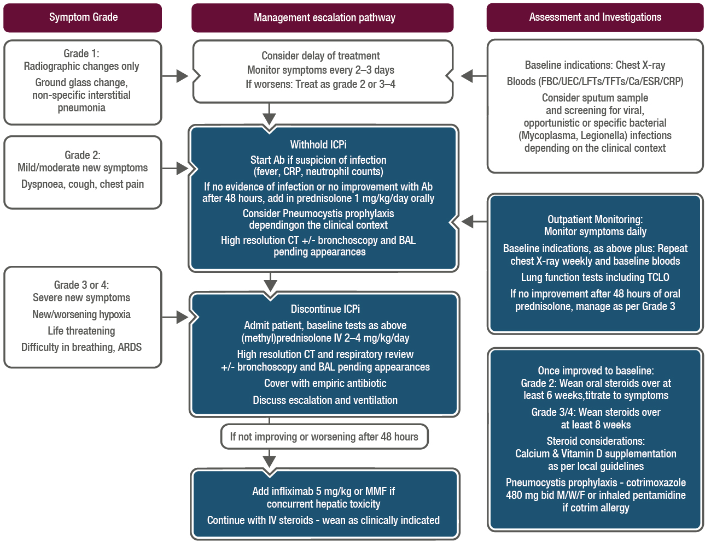
Immune related pneumonitis toxicities
ICPi-related toxicity: Management of pneumonitis
History:
Pulmonary hypertension/respiratory; disease/connective tissue disease; Influenza/Mycobacterium; tuberculosis exposure; Smoking history; Travel history; Allergy history including exposure to home/occupational aeroallergens
Differential Diagnosis:
Pneumonia (including atypical, pneumocystis, tuberculosis); Lymphangitis; Usual interstitial pneumonias; Pulmonary oedema; Pulmonary emboli; Sarcoidosis
© 2018 ESMO. All rights reserved. esmo.org/Guidelines/Supportive-and-Palliative-Care/Management-of-Toxicities-from-Immunotherapy

Slide 18
Summary of recommendations
Radiological features | Ground glass opacities A cryptogenic organising pneumonia-like appearance Interstitial pneumonia pattern Characteristics of hypersensitivity pneumonitis
Lung biopsy | Generally not required for patient management, unless there is doubt as to the aetiology of pulmonary infiltrates, when a VATS biopsy is the method of choice
Bronchoscopy with BAL | Supports the identification of infections and is recommended in any symptomatic pneumonia
Immune related pneumonitis toxicities
Any new respiratory symptom require prompt investigation to formally exclude lung toxicity and all patients presenting with pulmonary symptoms should be assessed by CT
© 2018 ESMO. All rights reserved. esmo.org/Guidelines/Supportive-and-Palliative-Care/Management-of-Toxicities-from-Immunotherapy

Slide 19
Summary of recommendations
Immune-related pneumonitis is documented or suspected | Immunosuppressive treatment should be started immediately
When no possibility to rule out infection using bronchoscopy | Oral or IV broad-spectrum antibiotics should be administered in parallel to the immunosuppressive treatment for grade ≥ 3 pneumonitis
Grade 1–2 | Oral prednisone 1 mg/kg daily or equivalent with clinical assessment every 2–3 days initially is recommended, with additional radiological assessments for grade 2 pneumonitis, and possible ICPi treatment interruption. Following recovery, steroids should be tapered over 4–6 weeks and ICPi treatment reintroduction delayed until the daily steroid dose is ≤ 10 mg of oral prednisone
Grade 3–4 moderate-to-severe cases | Hospitalisation, treatment with high dose IV (methyl)prednisolone 2–4 mg/kg/day or equivalent and permanent discontinuation of ICPi treatment is recommended If there is no improvement after 2 days, additional immunosuppressive strategies, such as infliximab, MMF or cyclophosphamide, are recommended Steroids should be tapered slowly over at least 6 weeks to prevent recurrence
Immune related pneumonitis toxicities
Management of pneumonitis
© 2018 ESMO. All rights reserved. esmo.org/Guidelines/Supportive-and-Palliative-Care/Management-of-Toxicities-from-Immunotherapy

Slide 20
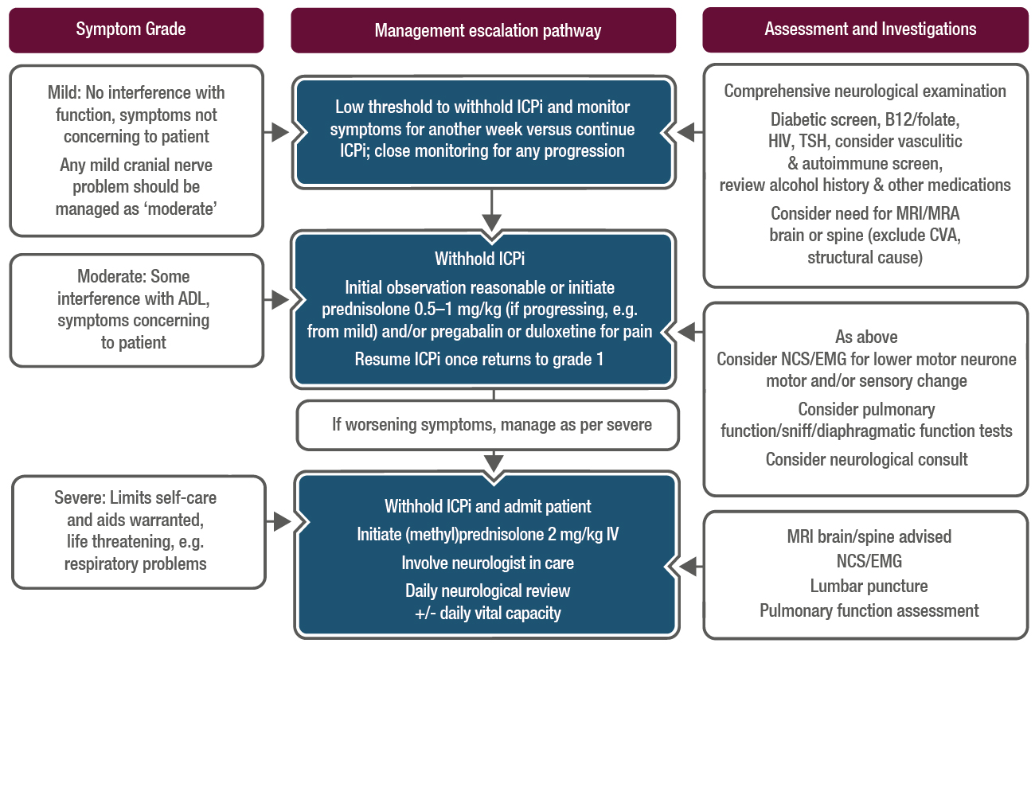
Rare immune-related toxicities
ICPi-related toxicity: Management of suspected peripheral neurological toxicity: mild, moderate or severe
Advice on steroid wean:
Conversion from IV to oral steroids at clinician discretion once improvement noted
Suggested oral prednisolone taper for 4–8 weeks
Consider PJP prophylaxis/Vitamin D if > 4-week duration
Multidisciplinary team involvement:
Physiotherapy, occupational therapy and speech therapy as appropriate, ophthalmology review for ocular/cranial nerve issues
Orthotic devices, e.g. for foot drop, should be considered
© 2018 ESMO. All rights reserved. esmo.org/Guidelines/Supportive-and-Palliative-Care/Management-of-Toxicities-from-Immunotherapy

Slide 21
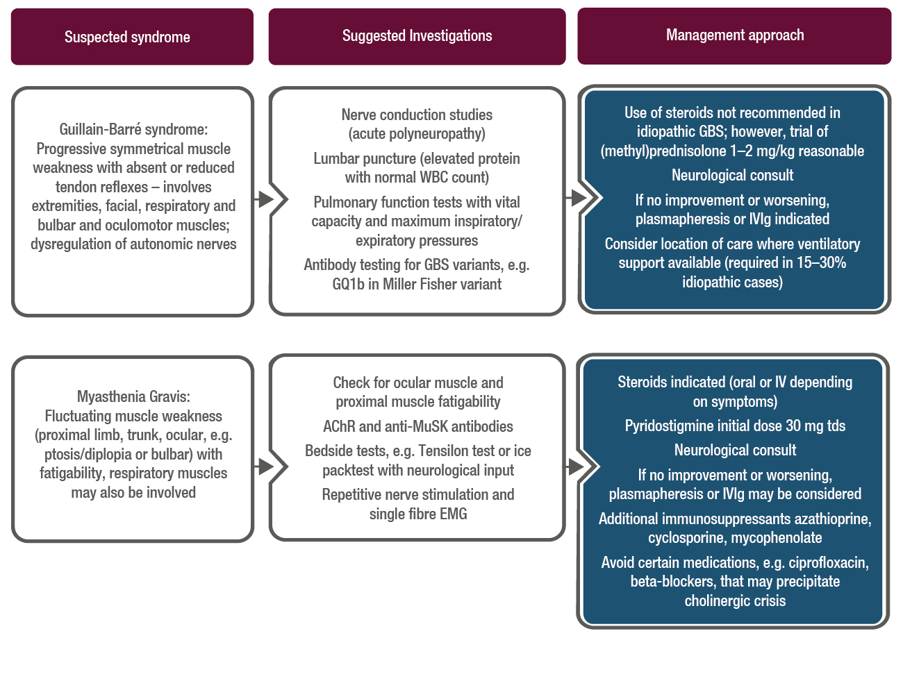
Rare immune-related toxicities
ICPi-related toxicity: Management of suspected peripheral neurological toxicity: Guillain-Barré and Myasthenia Gravis syndromes
Other syndromes reported:
Motor and sensory peripheral neuropathy, multifocal radicular neuropathy/plexopathy, autonomic neuropathy, phrenic nerve palsy, cranial nerve palsies (e.g. facial nerve, optic nerve, hypoglossal nerve)
Steroids suggested as initial management where indicated with neurology specialist input and close attention to potential for respiratory or visual compromise
© 2018 ESMO. All rights reserved. esmo.org/Guidelines/Supportive-and-Palliative-Care/Management-of-Toxicities-from-Immunotherapy

Slide 22
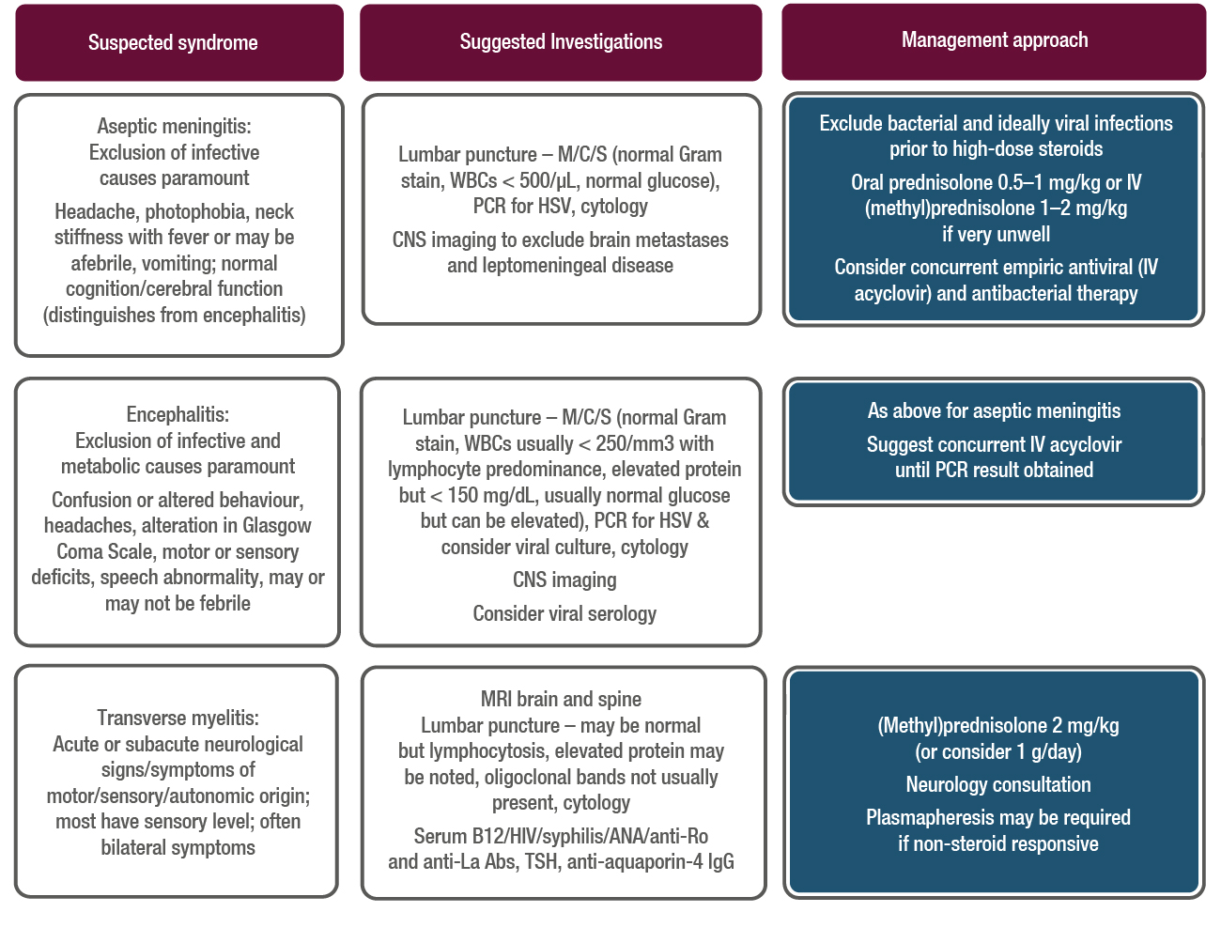
Rare immune-related toxicities
ICPi-related toxicity: Management of suspected central neurological toxicity
Other syndromes reported:
Posterior Reversible Leucoencephalopathy Syndrome (PRES), Vogt-Harada-Koyanagi syndrome, demyelination, vasculitic encephalopathy, generalised seizures
© 2018 ESMO. All rights reserved. esmo.org/Guidelines/Supportive-and-Palliative-Care/Management-of-Toxicities-from-Immunotherapy

Slide 23
Summary of recommendations
Time frame | A range of neurological events have been described with a time of onset from 6 to 13 weeks
Assessment | Progression of the underlying cancer, seizure activity, infection and metabolic derangement should be ruled out as causes and nerve conduction studies and lumbar puncture may assist in diagnosis
Management | Early consultation with a neurologist is advised For all but mild (grade 1) neurological symptoms, ICPi therapy should be withheld until the cause is determined Prednisolone 0.5–1 mg/kg should be considered for moderate symptoms High-dose oral prednisolone 1–2 mg/kg or IV equivalent is recommended for significant neurological toxicity Plasmapheresis or IVIg may be required for the treatment of myasthenia and GBS
Rare immune-related toxicities
Neurological toxicity
© 2018 ESMO. All rights reserved. esmo.org/Guidelines/Supportive-and-Palliative-Care/Management-of-Toxicities-from-Immunotherapy

Slide 24
Summary of recommendations
Circumstances | Cardiac side effects have been reported to occur after treatment with ipilimumab, pembrolizumab and nivolumab and the incidence is higher with the combination of ipilimumab and nivolumab compared with nivolumab alone
Management | Early consultation with a cardiologist is recommended High-dose corticosteroids should be instituted rapidly if ICPi-induced cardiac side effects are suspected Escalation to other immunosuppressive drugs, such as infliximab, MMF and ATG, is recommended if symptoms do not respond promptly to steroids
Rare immune-related toxicities
Cardiac toxicity
© 2018 ESMO. All rights reserved. esmo.org/Guidelines/Supportive-and-Palliative-Care/Management-of-Toxicities-from-Immunotherapy

Slide 25
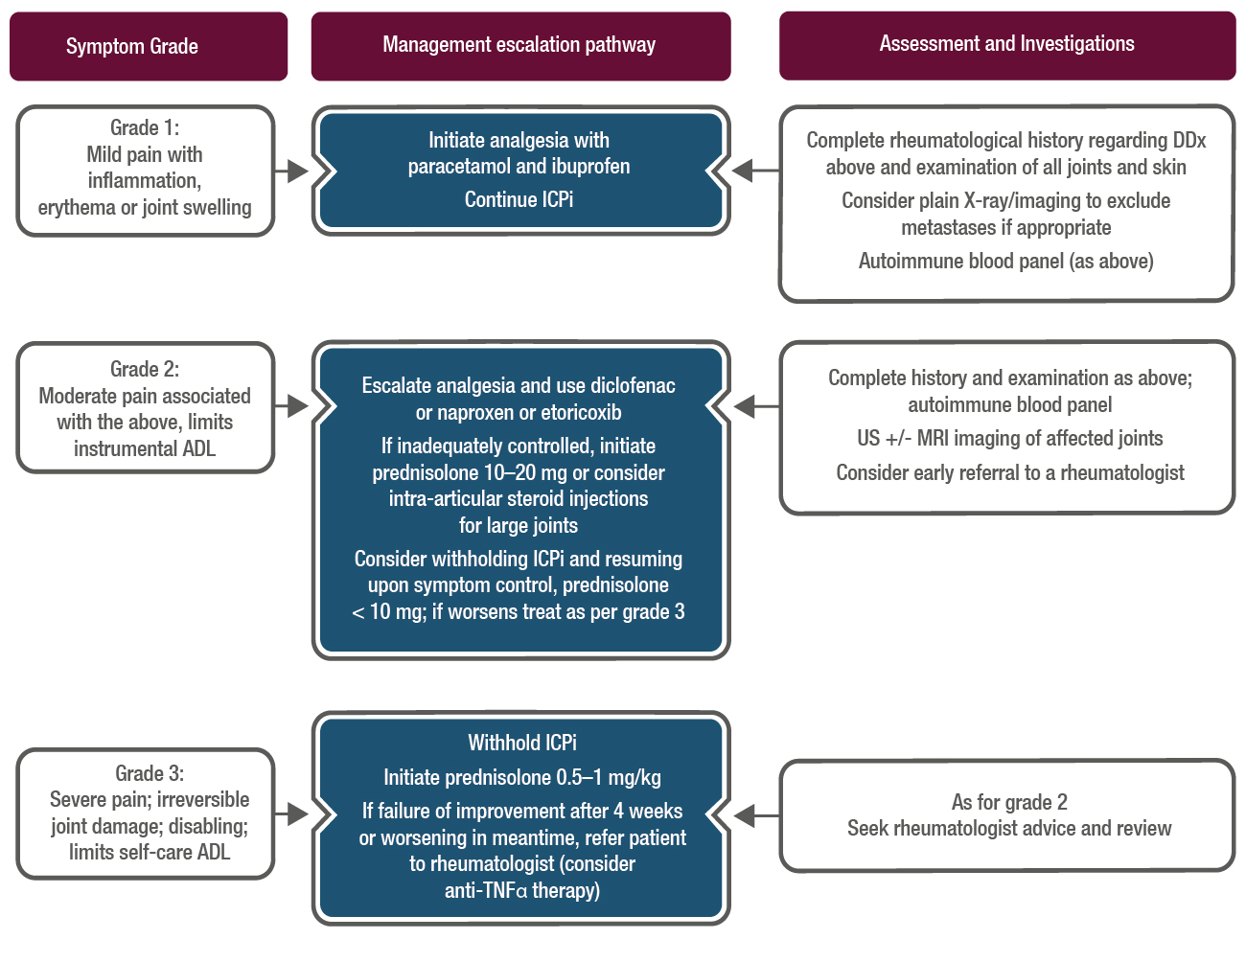
Immune related toxicities
ICPi-related toxicity: Management of arthralgia
Arthralgia: Pain in the joints without associated swelling; may be found in conjunction with myalgia (muscle pain), a common AE
DDx to consider:
Arthritis (see Figure 14 in the CPG for further tests and management)
Polymyalgia rheumatica (see arthritis as may present with small joint synovitis)
Myositis (characterised by tenderness to palpation of muscle)
Due to the paucity of literature on management of this AE, this algorithm serves as a general guide only; seek rheumatology advice if severe symptoms not responding to steroids
© 2018 ESMO. All rights reserved. esmo.org/Guidelines/Supportive-and-Palliative-Care/Management-of-Toxicities-from-Immunotherapy

Slide 26
Rare immune-related toxicities
Summary of recommendations
Mild or moderate symptoms | Analgesia with paracetamol and/or NSAIDs is recommended; moderate symptoms may respond to prednisolone
Severe symptoms | Consultation with a rheumatologist and the use of high dose corticosteroids and TNFα-blocking agents is recommended
Rheumatoligical toxicity
© 2018 ESMO. All rights reserved. esmo.org/Guidelines/Supportive-and-Palliative-Care/Management-of-Toxicities-from-Immunotherapy

Slide 27
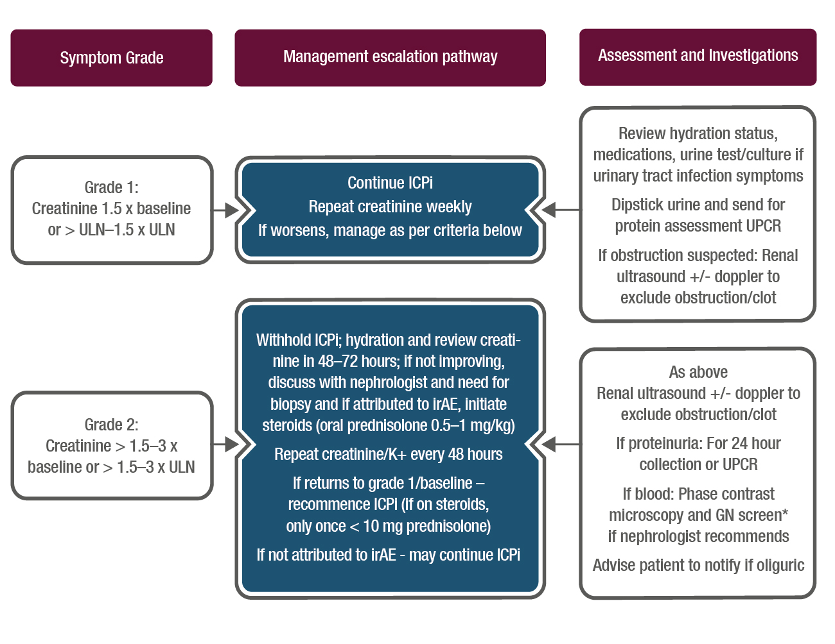
Rare immune-related toxicities
ICPi-related toxicity: Management of nephritis: grade 1-2
Renal injury occurs in around 1–4% of patients treated with ICPis, usually in a pattern of acute tubulo-interstitial nephritis with a lymphocytic infiltrate
Attention needs to be paid to the patient’s baseline creatinine, not just abnormal results per biochemistry ULN
Confounding diagnoses include dehydration, recent IV contrast, urinary tract infection, medications, hypotension or hypertension
Early consideration for renal biopsy is helpful which may negate the need for steroids and determine if renal deterioration related to ICPis or other pathology
Oliguria should prompt inpatient admission for careful fluid balance and plan for access to renal replacement therapy
Steroid wean: Begin to wean once creatinine grade 1; grade 2 severity episode: wean steroids over 2–4 weeks; grade 3–4 episode: wean over ≥ 4 weeks
If on steroids for > 4 weeks–PJP prophylaxis, calcium/vitamin D supplementation, gastric protection and check afternoon glucose for hyperglycaemia
*GN screen: ANA, complement C3, C4, ANCA, anti-GBM, hepatitis B and C, HIV, immunoglobulins and protein electrophoresis
© 2018 ESMO. All rights reserved. esmo.org/Guidelines/Supportive-and-Palliative-Care/Management-of-Toxicities-from-Immunotherapy

Slide 28
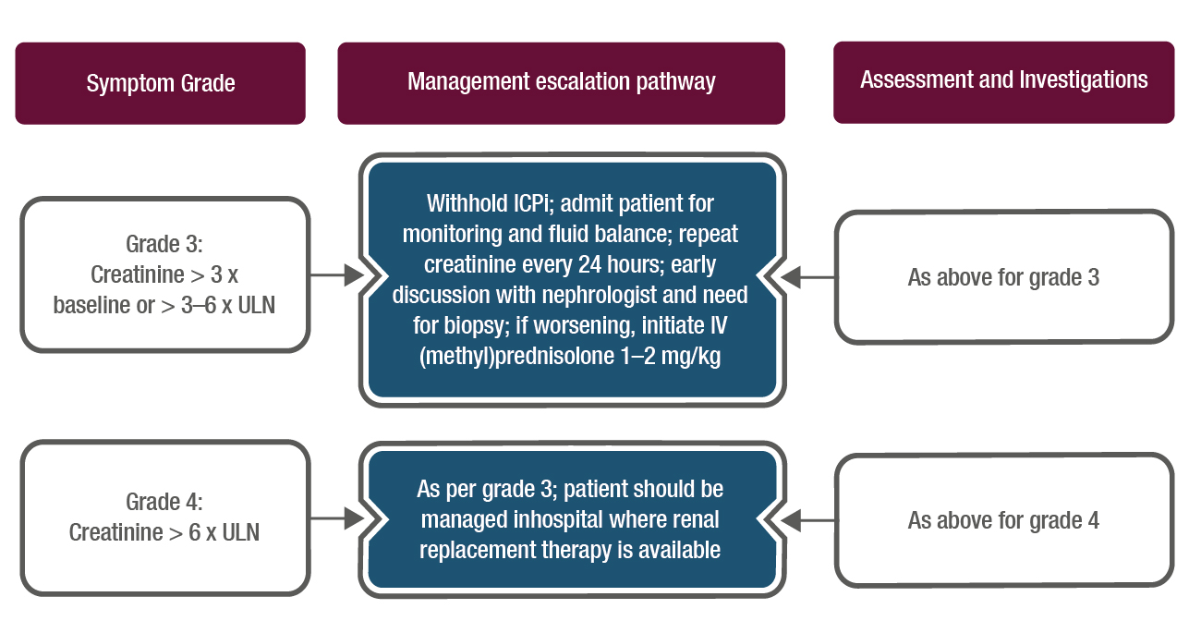
Rare immune-related toxicities
ICPi-related toxicity: Management of nephritis: grade 3-4
Renal injury occurs in around 1–4% of patients treated with ICPis, usually in a pattern of acute tubulo-interstitial nephritis with a lymphocytic infiltrate
Attention needs to be paid to the patient’s baseline creatinine, not just abnormal results per biochemistry ULN
Confounding diagnoses include dehydration, recent IV contrast, urinary tract infection, medications, hypotension or hypertension
Early consideration for renal biopsy is helpful which may negate the need for steroids and determine if renal deterioration related to ICPis or other pathology
Oliguria should prompt inpatient admission for careful fluid balance and plan for access to renal replacement therapy
Steroid wean: Begin to wean once creatinine grade 1; grade 2 severity episode: wean steroids over 2–4 weeks; grade 3–4 episode: wean over ≥ 4 weeks
If on steroids for > 4 weeks–PJP prophylaxis, calcium/vitamin D supplementation, gastric protection and check afternoon glucose for hyperglycaemia
© 2018 ESMO. All rights reserved. esmo.org/Guidelines/Supportive-and-Palliative-Care/Management-of-Toxicities-from-Immunotherapy

Slide 29
Summary of recommendations
Serum sodium, potassium, creatinine and urea prior to every ICPi treatment infusion is recommended
Initial management involves stopping nephrotoxic drugs, ruling out infection and urinary tract obstruction and correcting hypovolaemia
For significant renal dysfunction, ICPi treatment should be withheld and consideration given to the use of systemic (methyl)prednisolone 0.5–2 mg or equivalent
In the event of severe renal dysfunction, a nephrologist should be consulted
Renal biopsy may be used to clarify a difficult differential diagnosis
Acute tubulo-interstitial nephritis with lymphocytic infiltration is a frequent biopsy finding
Rare immune-related toxicities
Renal toxicity
© 2018 ESMO. All rights reserved. esmo.org/Guidelines/Supportive-and-Palliative-Care/Management-of-Toxicities-from-Immunotherapy

Slide 30
Summary of recommendations
Ocular toxicities
Topical corticosteroids are recommended for episcleritis and anterior uveitis and systemic corticosteroids for severe ocular inflammation and orbital inflammation
Intravitreal anti-VEGF treatment is recommended for choroidal neovascularisation
Haematological toxicities
The optimal treatment for immune-related haematological AEs is unknown and initiation of high-dose corticosteroids and other immunosuppressive drugs should be performed in close collaboration with a haematologist
Allograft rejection
Use of ICPis may induce graft rejection. The risk of allograft rejection is probably lowest for anti-CTLA-4
Rare immune-related toxicities
Ocular toxicities
Haematological toxicities
Allograft rejection
© 2018 ESMO. All rights reserved. esmo.org/Guidelines/Supportive-and-Palliative-Care/Management-of-Toxicities-from-Immunotherapy

Slide 31
Disclaimer and how to obtain more information
This slide set provides you with the most important content of the full ESMO Clinical Practice Guidelines (CPGs) on the management of toxicities from immunotherapy. Key content includes diagnostic criteria, staging of disease, treatment plans and follow-up.
The ESMO CPGs are intended to provide you with a set of recommendations for the best standards of care, using evidence-based medicine. Implementation of ESMO CPGs facilitates knowledge uptake and helps you to deliver an appropriate quality of focused care to your patients.
This slide set contains information obtained from authentic and highly regarded sources (www.esmo.org). Although every effort has been made to ensure that treatment and other information are presented accurately in this publication, the ultimate responsibility rests with the prescribing physician. Neither the publisher nor the ESMO Guidelines Committee can be held responsible for errors or for any consequences arising from the use of information contained herein. For detailed prescribing information on the use of any product or procedure discussed herein, please consult the prescribing information or instructional material issued by the manufacturer.
The slide set can be used as a quick reference guide to access key content on evidence-based management and individual slides may be used for personal presentation in their present version and without any alterations. All rights reserved.
© 2018 European Society for Medical Oncology Please visit www.esmo.org or oncologypro.esmo.org to view the full guidelines.

Slide 32
Immunotherapy-Related Side Effects and their Management
Survivorship

